Slide 1

The Effect of Mask Type on the Spread of COVID-19 on a College Campus
Katrina Janeczko

Slide 2
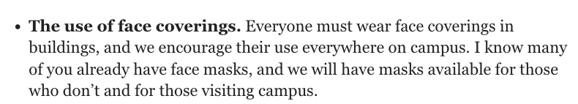
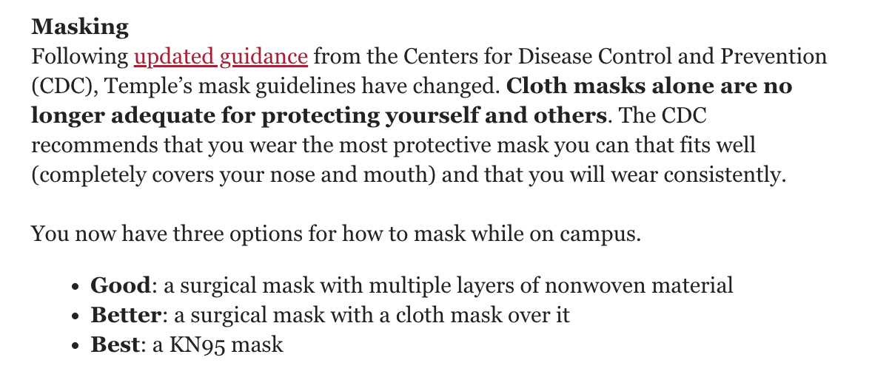
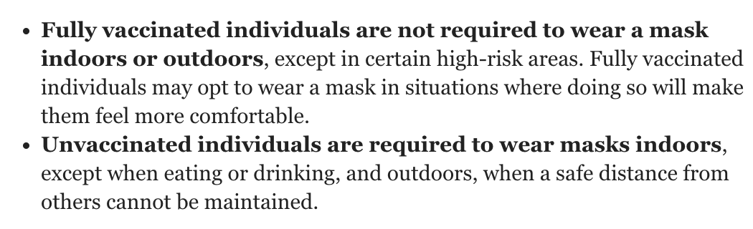
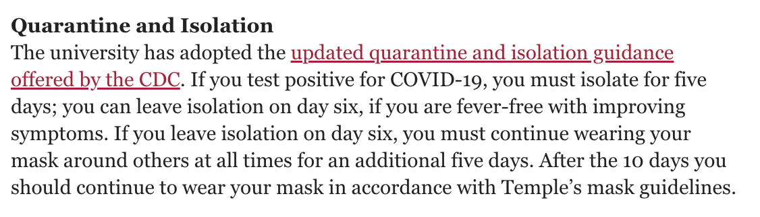
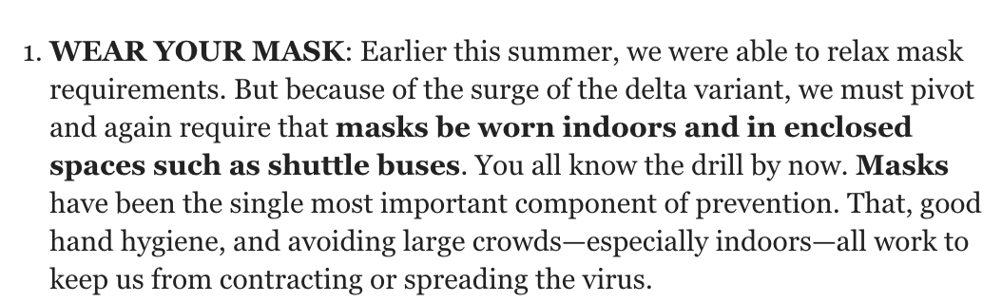
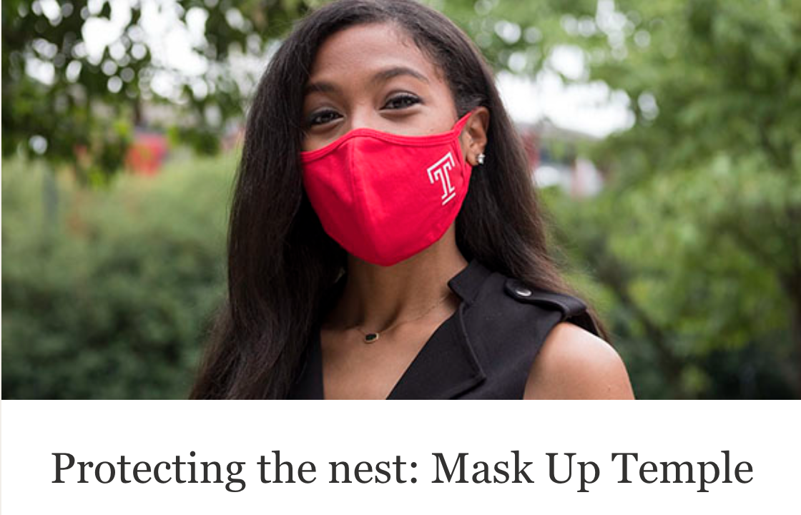
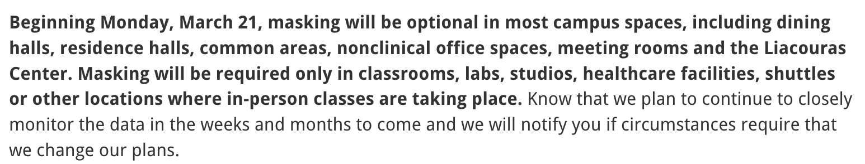
- Englert (June 2, 2020)
- Englert (June 18, 2021)
- Mandel (Jan. 21, 2022)
- Wingard (Aug. 10, 2021)
- Nutshell
(Aug. 17,
2020)
- Mandel (Mar. 11, 2022)

Slide 3
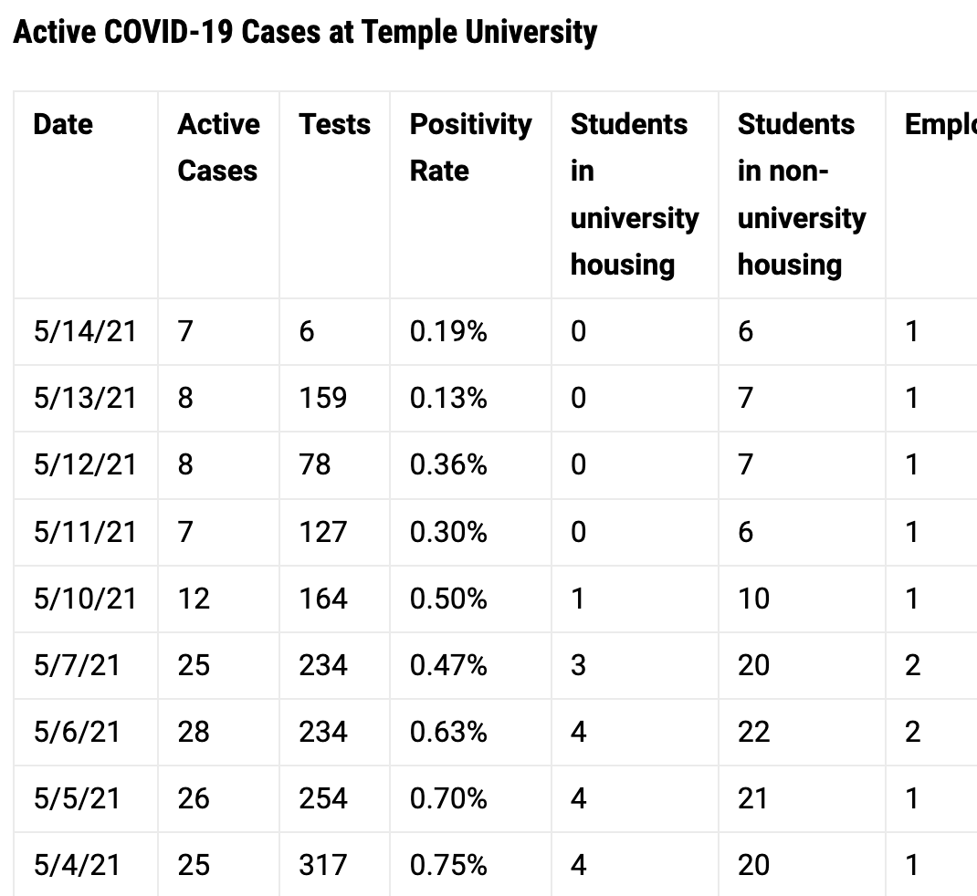
Introduction
Mask mandate inconsistency
Masks vs COVID-19 infections in a student population
Does mask type really matter?
CDC: Even a cloth mask reduces the odds infection by 44%
Tracking COVID-19 Cases at Temple University, Temple News, 2021

Slide 4
Questions
Does mask type really matter?
How do different ratios of mask types in a student population affect:
… number of students total infected?
… speed of spread?
How important is it to follow a mask mandate? How effective is it?
The point of the model

Slide 5
Assumptions
Agents wear same mask throughout semester, and do not remove it
1% of Temple population to represent whole population at scale
Infected students randomly spawned
Represent students bringing infection from elsewhere
Agents continue to move all day long and don’t go to sleep
For simplicity, ignore vaccinations and use same base value for infection for any agent
Focus on mask type
Infection potential depends only on mask wearer
Everyone quarantines when they’re supposed to (6 days)
Finished quarantine = immune for rest of simulation (semester)
Notes:
Agents who have finished quarantine are regarded as immune for the rest of the simulation, (semester) even though we do not know if COVID works in that way
In the simulation, agents will wear the same mask throughout the semester, and not remove it. While this is not true, we can assume that the overall amounts of students wearing certain masks won’t fluctuate too much
We use 1% of the Temple population to represent the whole population at scale
Infected students are randomly spawned in to represent students who have brought COVID to campus.
The agents continue to move all day long and don’t go to sleep, but if agents only moved during peak hours, the q_base would simply change to match COVID’s r₀ value
For simplicity, ignored vaccinations and used the same base value for infection for any agent, so that mask type was the only differentiating factor.
Assume everyone quarantines when they’re supposed to (6 days)

Slide 6
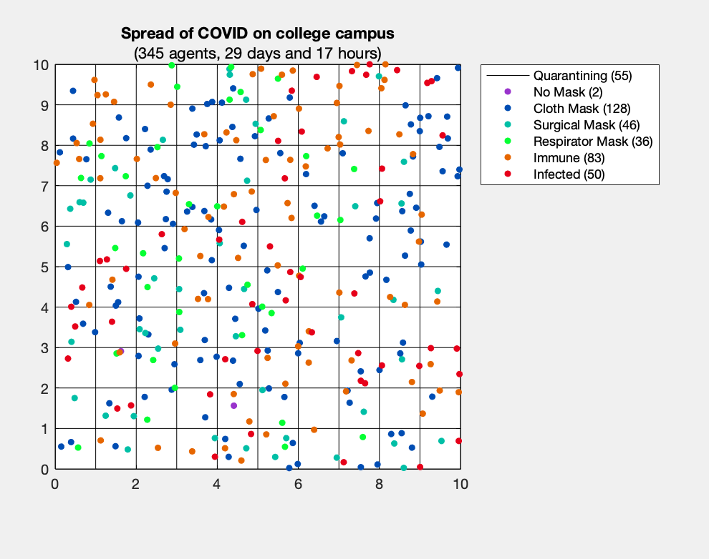
Subplot 1: 10x10 grid
Each cell = room/common space
395 agents initially; random directions
Color based on mask type, infected, or immune
Every step, infected agents sharing cell with other agents (students in close proximity) have base chance to infect [q_base]
Modified by mask type [q_modifier]
There are 24 steps in a day
Infected agents stay in simulation for 6 days until quarantine for another 8 days (14 total)
Reintroduced as immune
Notes:
10x10 grid, each cell representing a room
Starts with 395 agents, each moving in random directions
Agents are colored differently based on the type of mask they are wearing, or if they are infected or immune
Every step, infected agents who share a cell with other agents (representing people in close proximity to each other) have a base chance to infect them. [q_base]
This chance is modified by the type of mask that they are wearing [q_modifier]
There are 24 steps in a day
Agents that are infected will stay in the simulation for 6 days until they quarantine for another 8 days (14 total)
They will then return as immune, unable to become infected again for the rest of the simulation

Slide 7
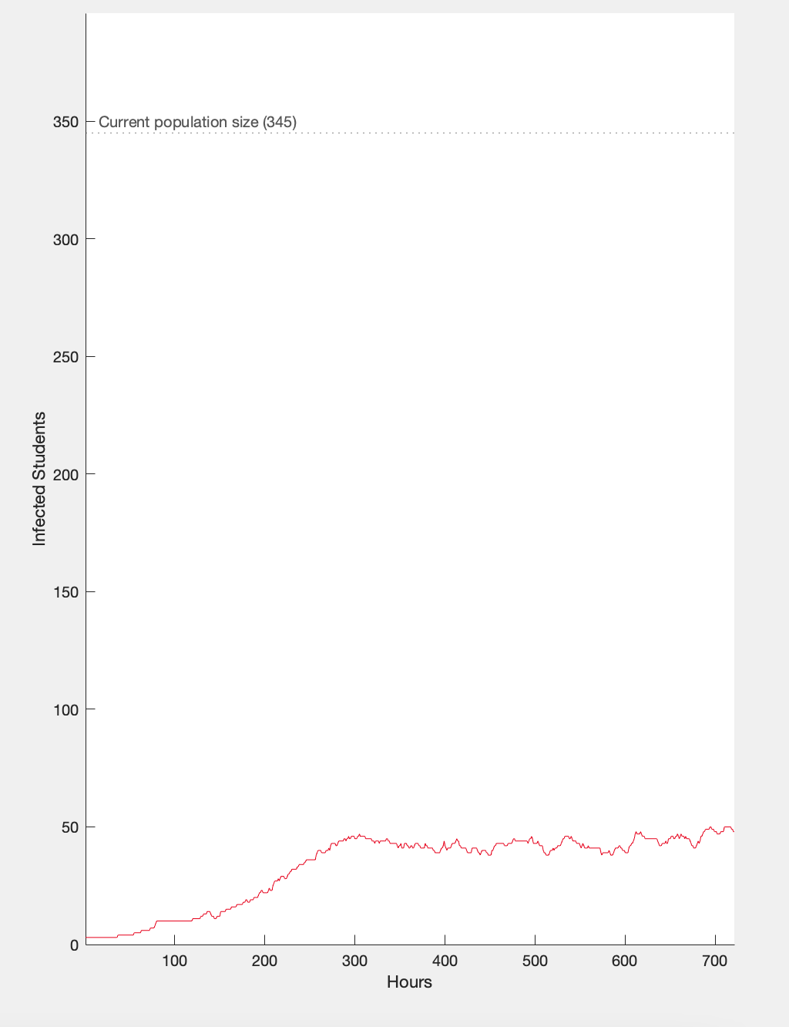
Subplot 2: Line Graph
Axes
X axis representing duration of simulation
Y axis representing percentage of active population (not quarantining) that is infected
Visual for how population is affected over time and how variable changes affect simulation
Notes:
Description of the agents, states, environment, and how the states are updated each time step.

Slide 8
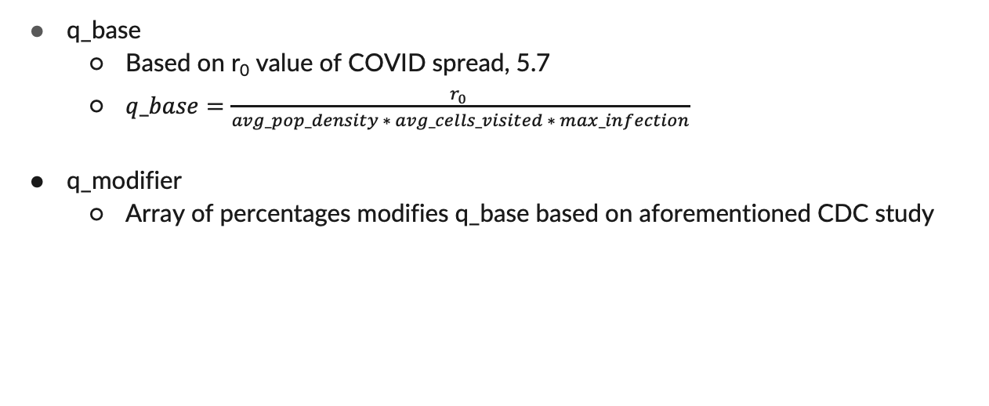
Variables
q_base
Based on r₀ value of COVID spread, 5.7
$q_base=\frac{r_{0} }{avg_pop_density ∗ avg_cells_visited ∗ max_infection}$
q_modifier
Array of percentages modifies q_base based on aforementioned CDC study
No mask | Cloth Mask | Surgical Mask | Respirator Mask
1 | 0.44 | 0.34 | 0.17
Notes:
Description of the agents, states, environment, and how the states are updated each time step.

Slide 9
Variables
N
Initial amount of agents (395) (1% of 39,581, Temple’s student population)
i
Initial percentage of infected agents (0.19%)
Based on day 1 positivity rate from Temple’s COVID tracker
max_infection, quarantine_over
Symptoms around 6 days after infection → quarantine
14 days after infection → immune / quarantine over
Notes:
Description of the agents, states, environment, and how the states are updated each time step.

Slide 10
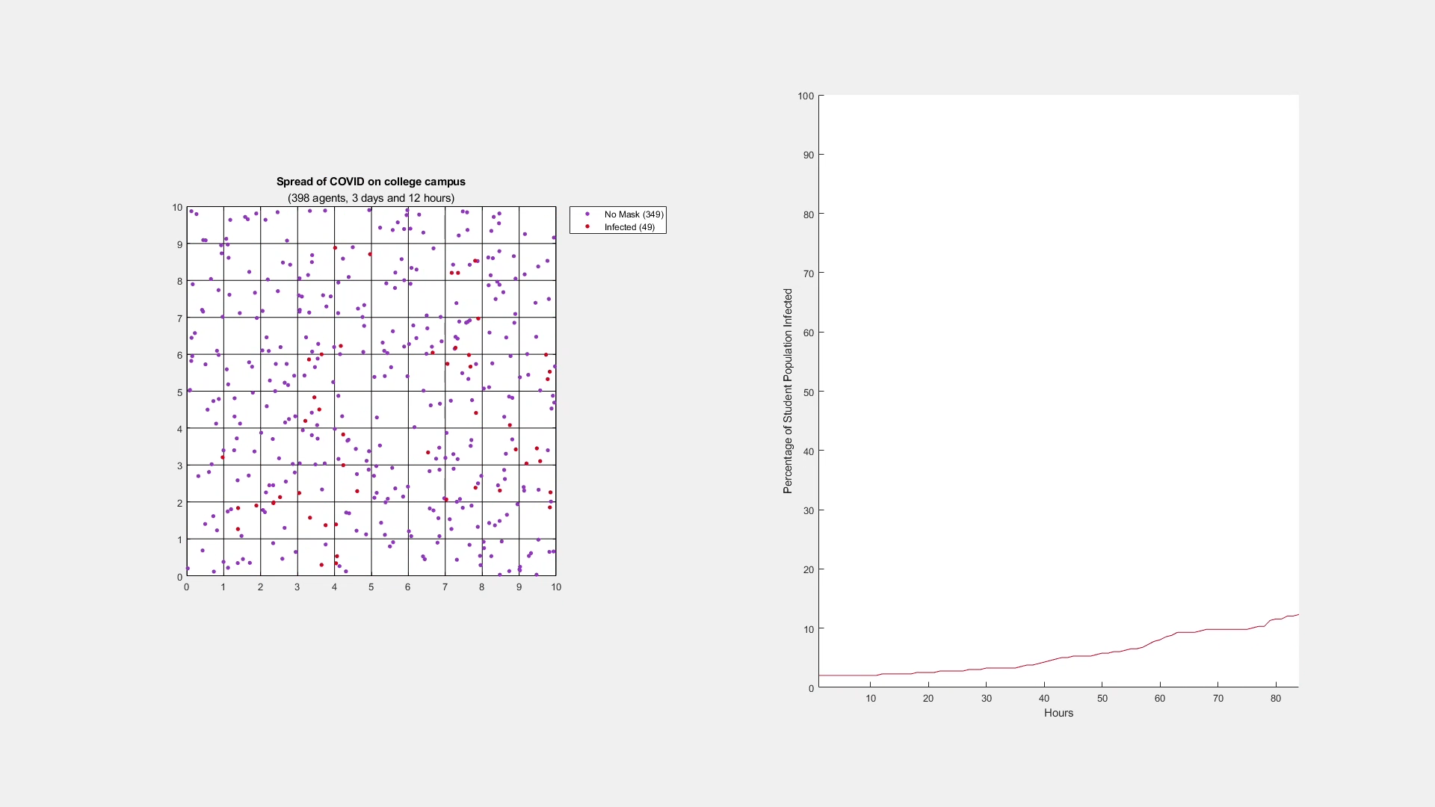
No masks
Notes:
Visuals of the outputs of your model. If you create a visual at each time step, I urge you to create a video so we can see how your simulation progresses.
You should run multiple scenarios where you change some variables in your model and explain how that changes outcomes.

Slide 11
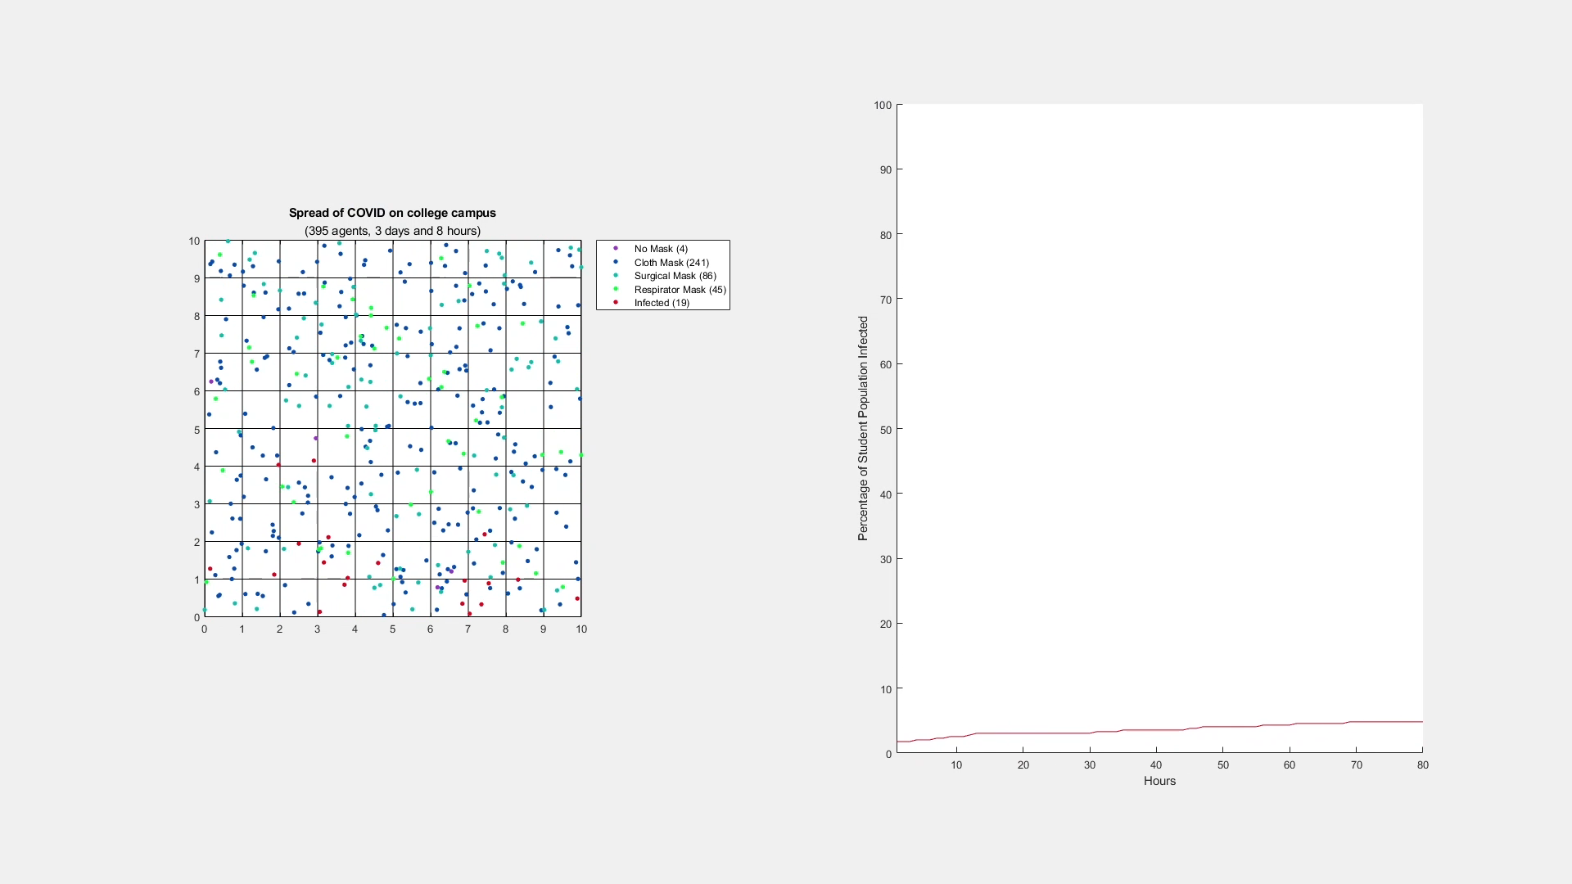
Standard Mask Mandate
Notes:
Visuals of the outputs of your model. If you create a visual at each time step, I urge you to create a video so we can see how your simulation progresses.
You should run multiple scenarios where you change some variables in your model and explain how that changes outcomes.

Slide 12
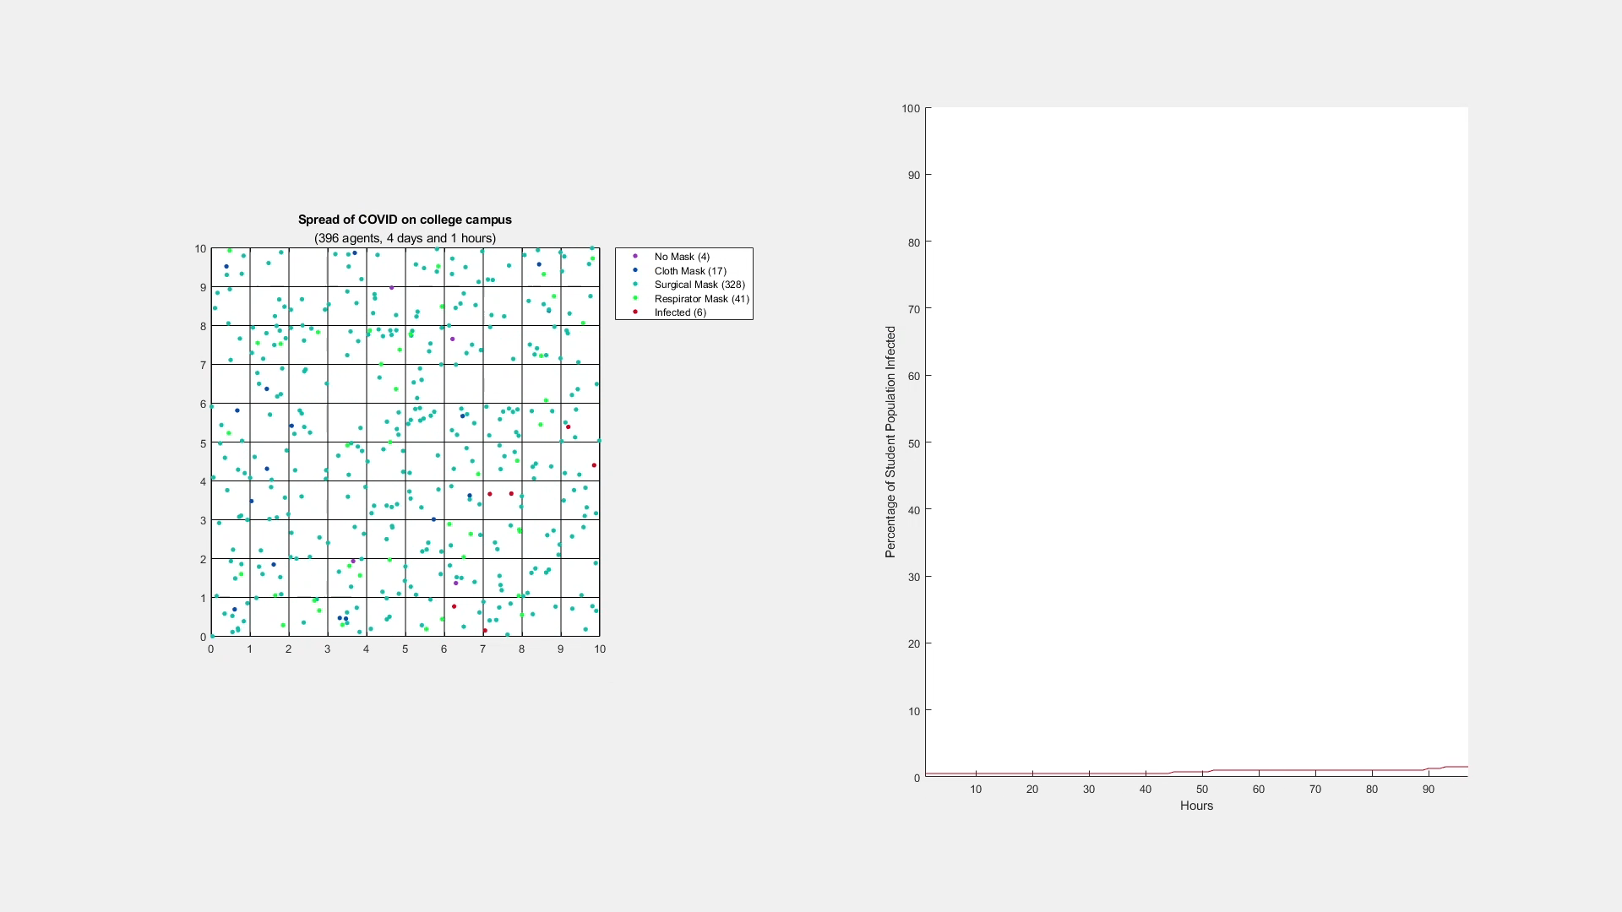
Surgical Mask Mandate
Notes:
Visuals of the outputs of your model. If you create a visual at each time step, I urge you to create a video so we can see how your simulation progresses.
You should run multiple scenarios where you change some variables in your model and explain how that changes outcomes.

Slide 13
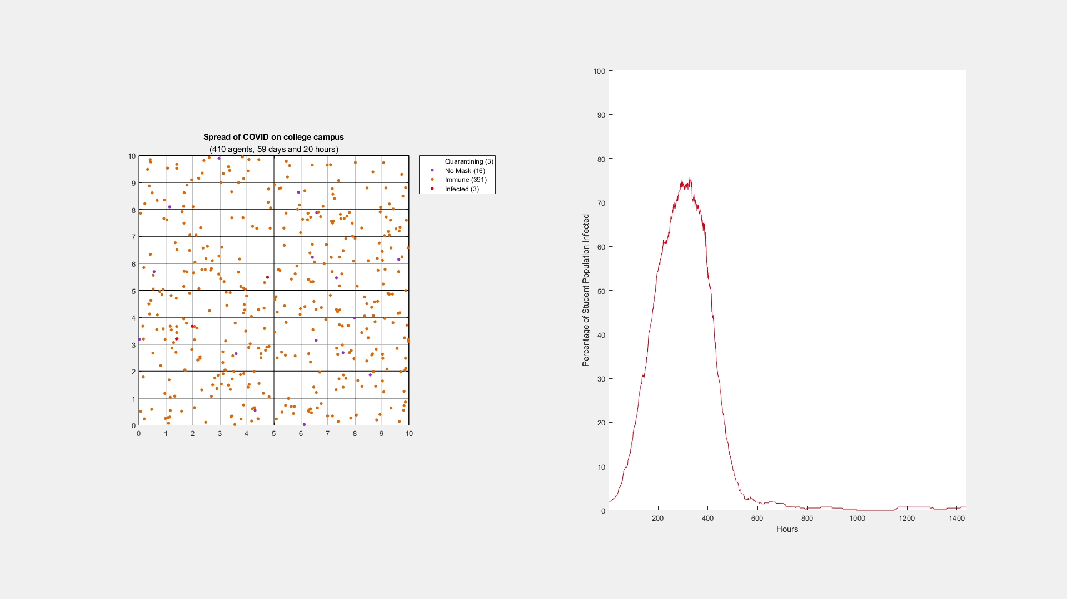
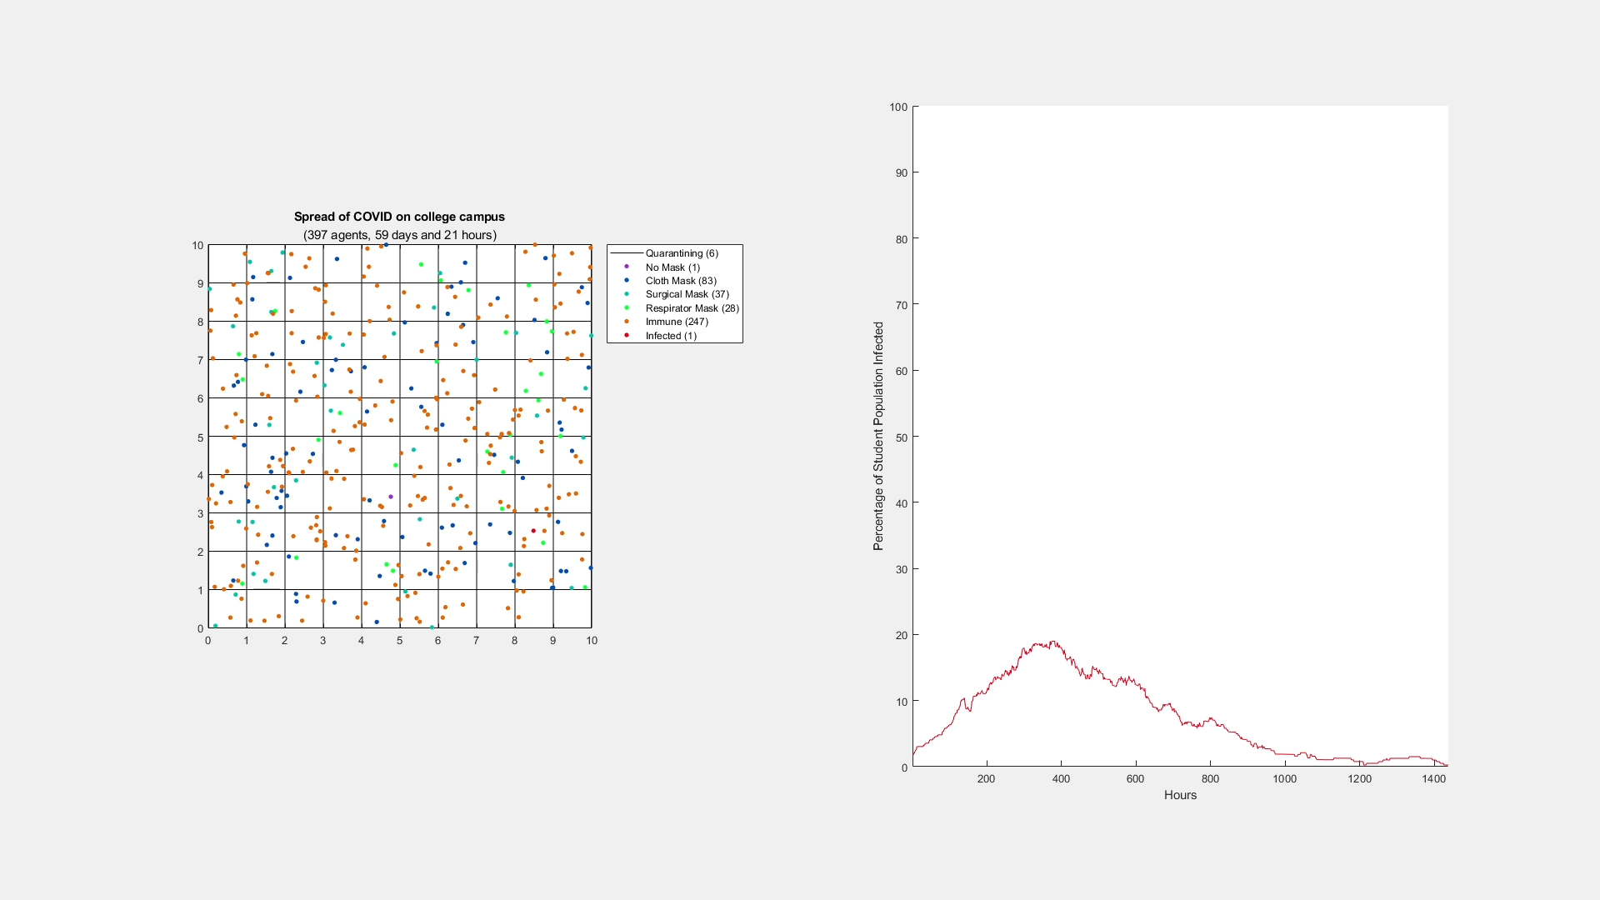
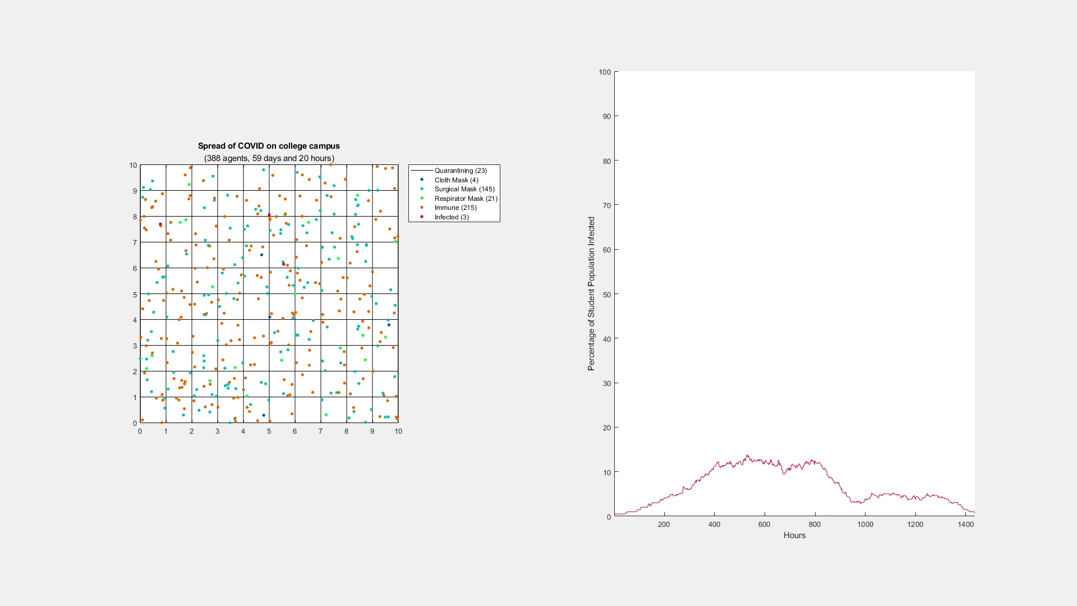
1. No masks
2. Mask mandate
3. Surgical mandate
Better masks = slows spread over time
“Flattening the curve”
Notes:
Visuals of the outputs of your model. If you create a visual at each time step, I urge you to create a video so we can see how your simulation progresses.
You should run multiple scenarios where you change some variables in your model and explain how that changes outcomes.

Slide 14
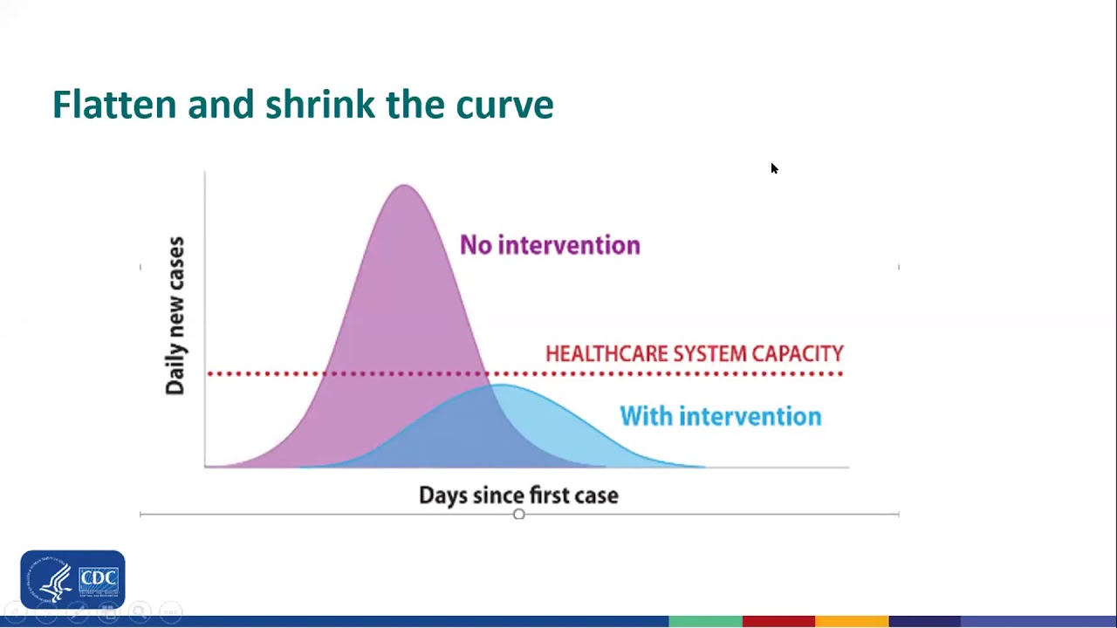
Flattening the Curve
From the CDC 2021

Slide 15
Difficulties & Complications
Representing mask type condition variable types – discernability
Initially, subplot 2 showed number of students infected, not percentage of population that is infected
Finding an appropriate q_base (base chance of agents infecting other agents in their cells)
Notes:
The difficulties or complications you ran into with your project and what you did to try to overcome these difficulties.

Slide 16
Conclusions
Mask mandate is effective, not only to ‘flatten the curve,’ but to reduce the overall number of infections in a semester
The difference between a standard mandate and a surgical mandate is less noticeable than the difference between a mandate and no mandate in terms of flattening the curve, but a surgical mask mandate still reduces the amount of total cases compared to a standard mandate
Furthermore, in any simulation, those who wear more protective masks will stay in the simulation longer
Notes:
The answer(s) you arrived at.

Slide 17
Conclusions
Mask type does matter!
Mask mandate = effective
Flattens curve, slows spread
Reduces total infections in a semester
Answers of initial questions

Slide 18
Bibliography
CDC study about mask protection rates for q_modifier: https://www.cdc.gov/mmwr/volumes/71/wr/mm7106e1.htm?s_cid=mm7106e1_w%20[cdc.gov]
Temple COVID tracker for i: https://temple-news.com/trackingcovid19/
Notes:
The difficulties or complications you ran into with your project and what you did to try to overcome these difficulties.

